Slide 1

EmpowerFit
Anjalee Daowdat

Slide 2

WIREFRAME
Logo
Slideshow

Slide 3

WIREFRAME
Mandatory fields
Button

Slide 4

WIREFRAME
Scrolling Feature
Testimonials Paragraphs

Slide 5
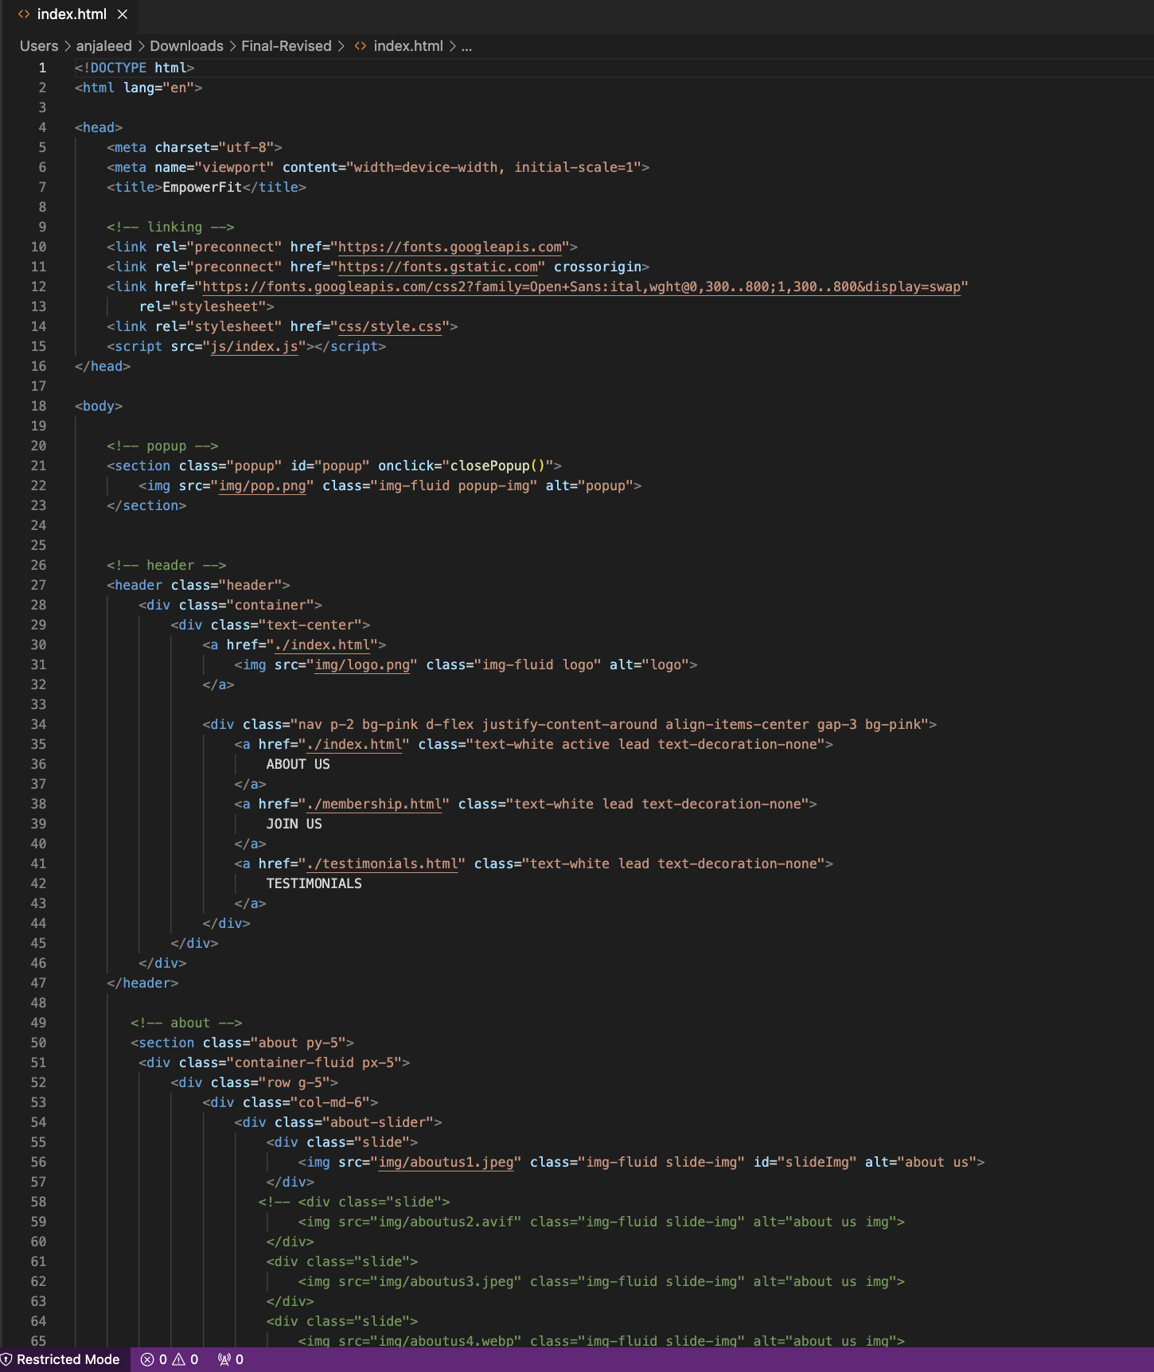
index.html

Slide 6
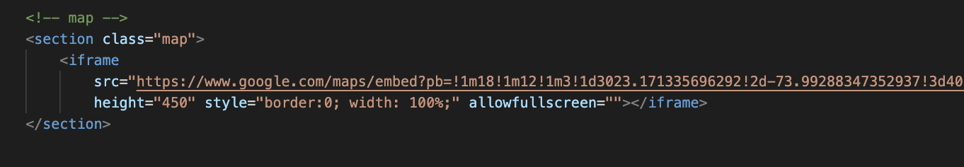
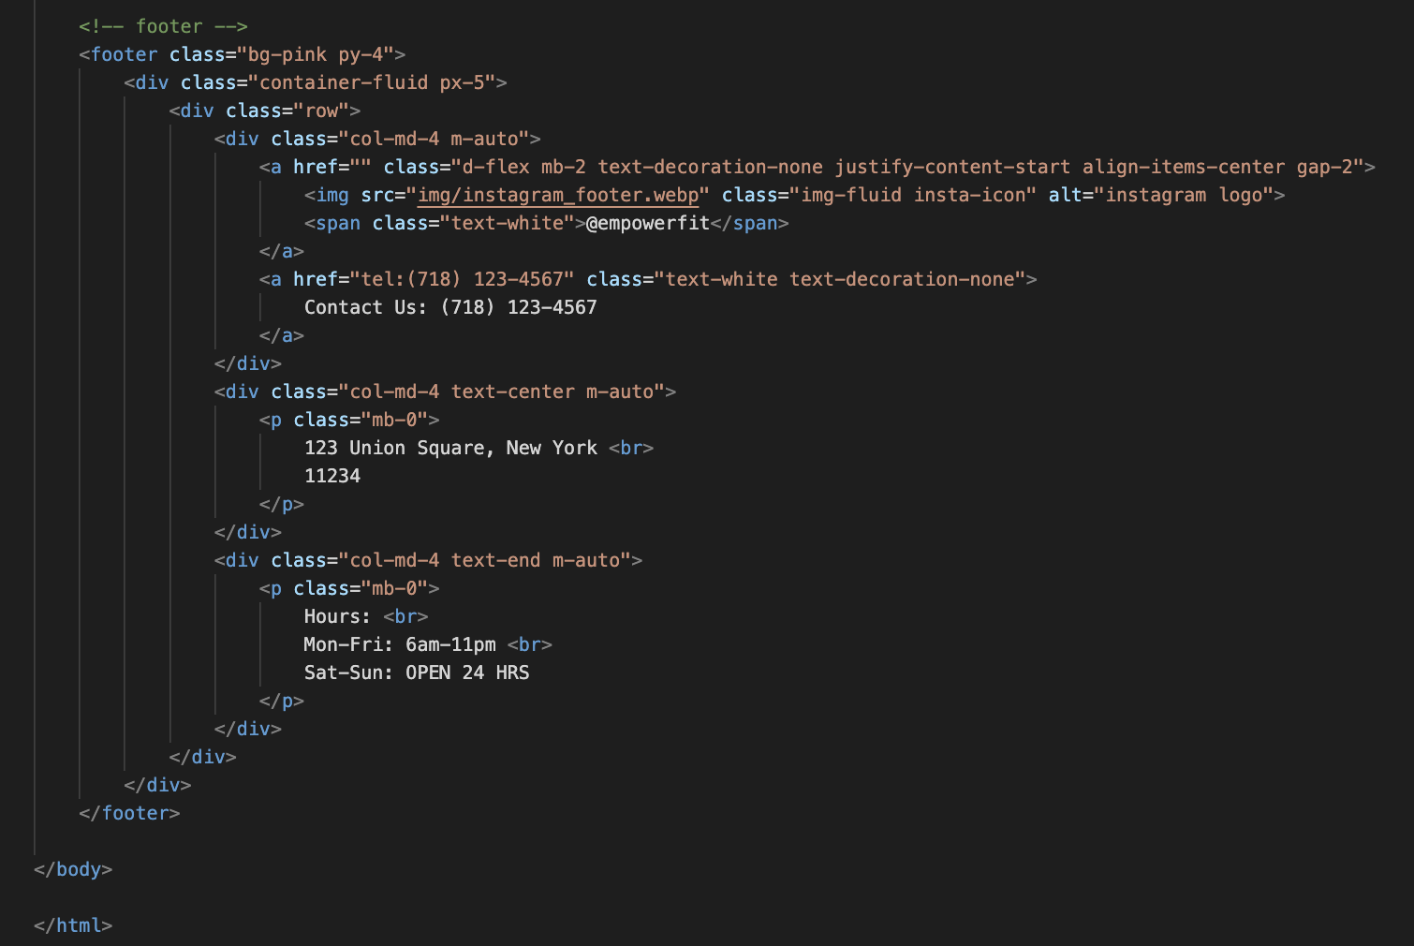
index.html
Image Slideshow
Iframe: inline frame used to display Google Maps marker within html page
Footer Content:
<div> Defines a section and groups the section

Slide 7
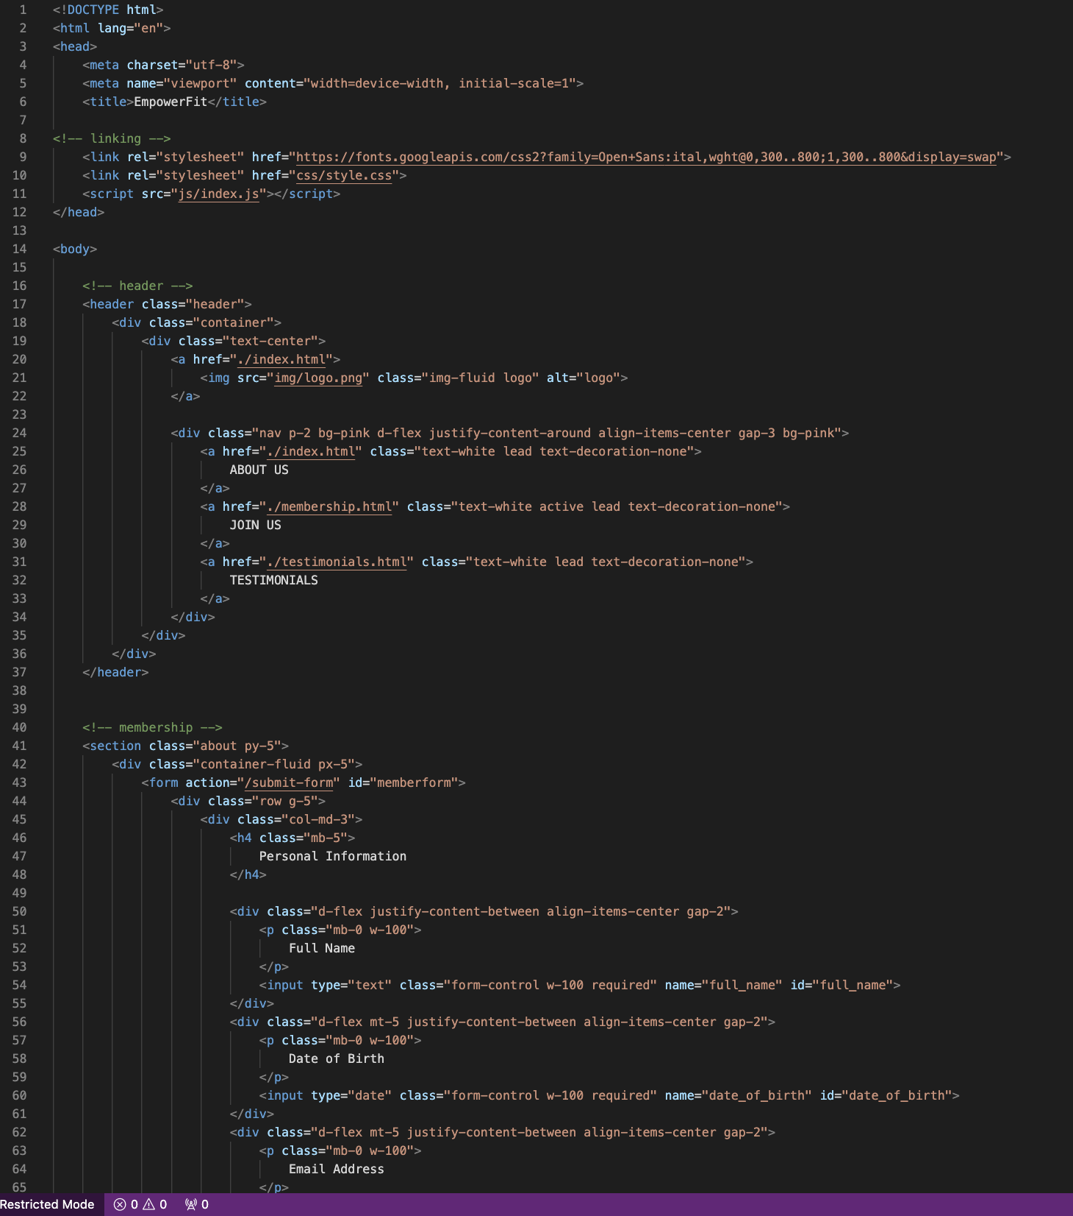
membership.html

Slide 8
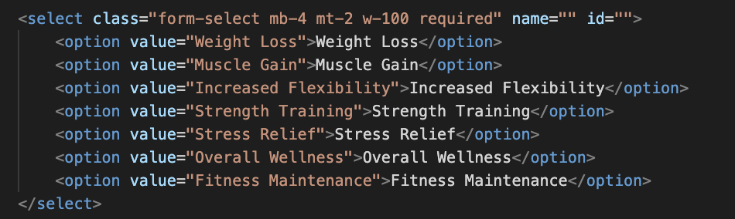
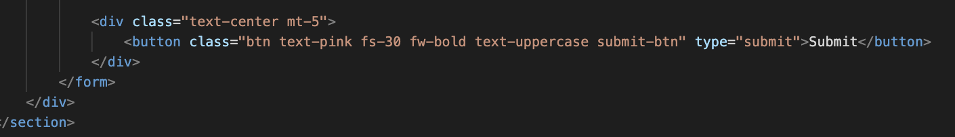
membership.html
<select>
<option>
Allows user to select an option from the dropdown menu
type= :Defines type of button
Class: CSS classes

Slide 9
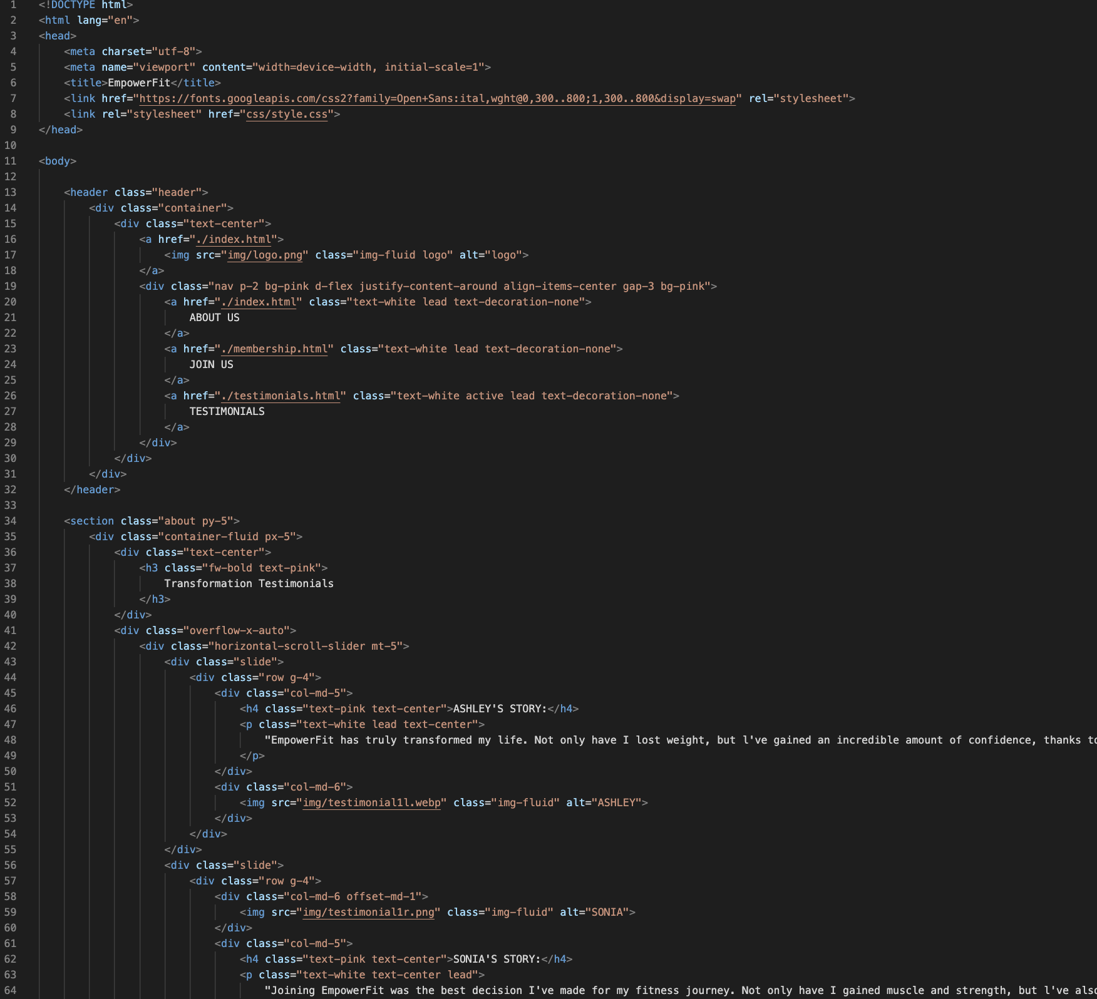
testimonials.html

Slide 10
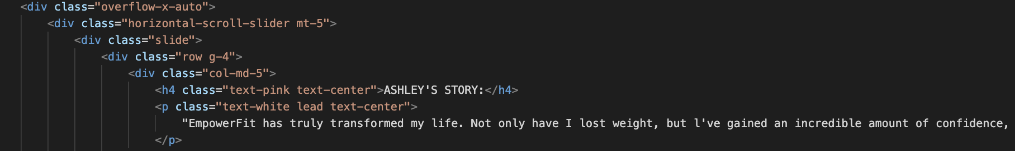
testimonials.html
“Overflow-x-auto” : contains content that might overflow
Div class= “slide” : single slide within the horizontal slider

Slide 11
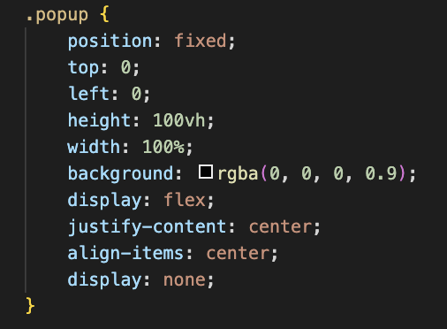
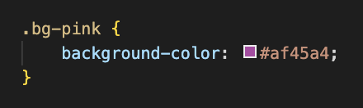
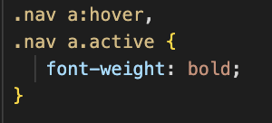
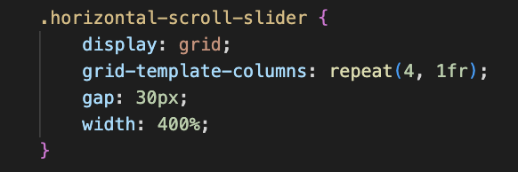
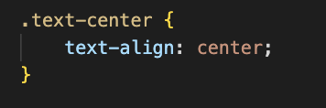
styles.css

Slide 12
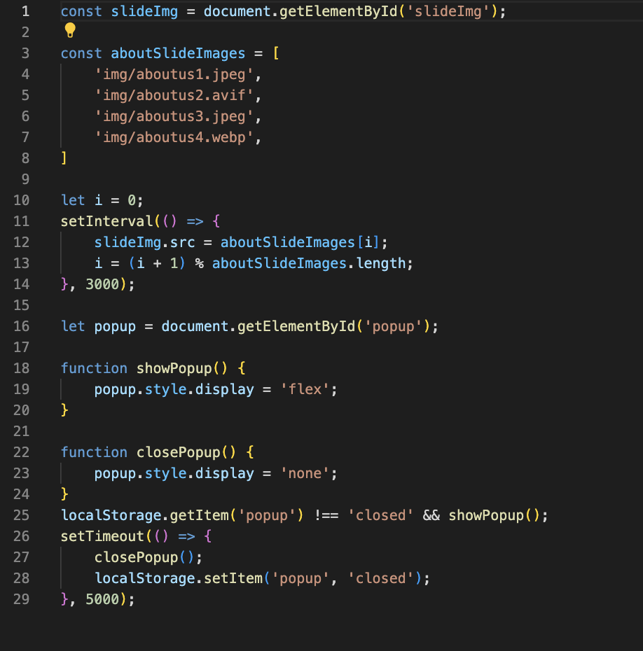
index.js
Slideshow & Pop Up:
setInterval(() => { ... }, 3000);: Sets an interval function that changes image in every 3 seconds.
localStorage.getItem('popup') !== 'closed' && showPopup();: Checks if the popup has not been closed before and if not, displays the popup.

Slide 13
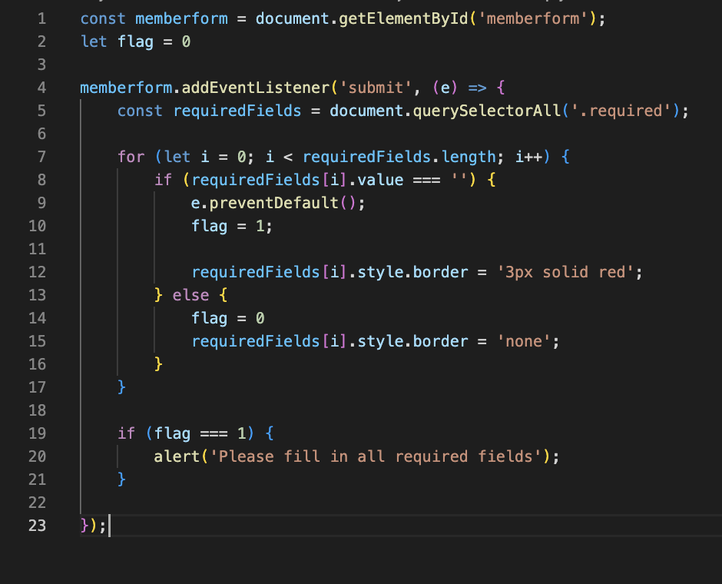
membership.js
let flag = 0: Initiates flag variable to track if required fields are empty.
const requiredFields = document.querySelectorAll('.required');: Elements with the class .required: Shows the required fields in the form.
If flag is still 1, an alert will pop up so the user fills in all required fields.

Slide 14
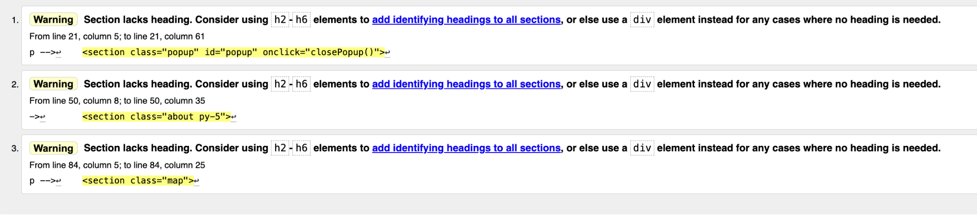
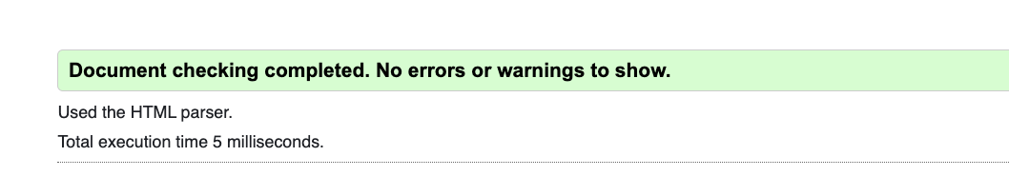
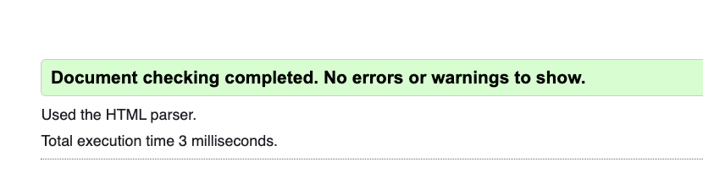
WC3 Validation

Slide 15
EmpowerFit

